Slide 1

TianShan Arch Introduction
Hui Shao, 2006
TianShan Series - 1
Introduction to Architecture & Components
Hui Shao, 2006, 2009

Slide 2
Overview of the Series of TianShan Training
Introductions to Architecture & Components
Content and Content Provisioning
Transport Abstraction and Stream Session
Foundational Applications
Event Delivering and Monitor Subsystem
TianShan in SeaChange NGOD/CDN/HSN Products

Slide 3
Contents
Background
  Demands on “Open On-Demand System”
  Why wasn’t Axiom
The TianShan Architecture
  Architectural Goals
  Architectural Work Through
  Interface and Logical Components
  Comparetion with Other Architecture
The TianShan Product and Key Components
  The TianShan Kit
  Weiwoo and Path Helper Objects
  SiteAdminService
  StreamSmith
  RTSP Proxy and ssm Plugins
  ContentStore
  ContentProvisionEngine and Content Provision Helpers
  Foudational Application ServicesL MovieOnDemand, ChannelOnDemand
  Sentry
  EventChannel and EventGateway
Deployment and Support

Slide 4
Background
Demands on “Open On-Demand System”
  Market demands
  ZQ internal needs
Why wasn’t Axiom …
Notes:
A client to drive VOD thru Axiom¡¯s MOD or Zero application. Samples like autoplay.
An application with ISSAPI, a misled story: STV_playback
Long and complex work flow to add new bushiness logic
Hardly to add user data, could be filter out at any step
Valuable features go to naught: splicing, advertising and so on

Slide 5
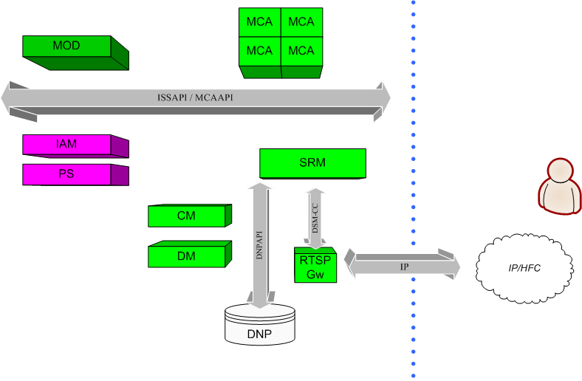
Background (Cont-1)
Introduction to Axiom workflow

Slide 6
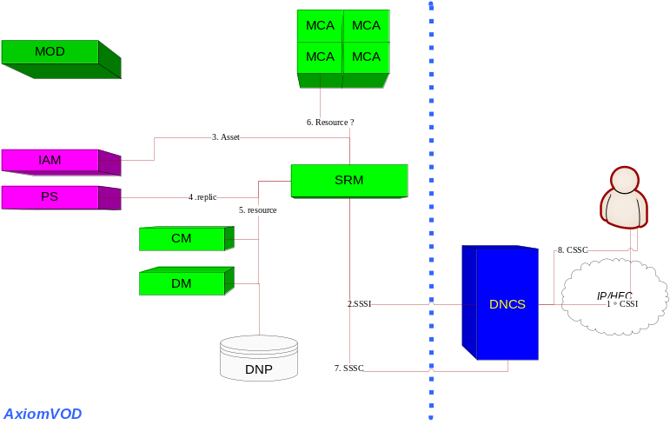
Background (Cont-2)
Why wasn’t Axiom
  “Axiom was designed for its MOD application”
    IAM, IPS, ICM, ISRM and more knew everything about the MOD application. Business logic has never been touched until session has been set up
      The first entry to MOD: SSAPI_OnNewStream() – too late
      The ordered asset is not explained by business logic but by ISRM and IAM
      Some reserved doors opened for SeaChange’s own MOD but not for any other 3rd party applications
    It is painful to host a new application or business logic other than MOD
      A client to drive VOD thru Axiom’s MOD or Zero application. Samples like autoplay.
      An application with ISSAPI, a misled story: STV_playback
      Long and complex work flow to add new bushiness logic
      Hardly to add user data, could be filter out at any step
      Valuable features go to naught: splicing, advertising and so on
  Loose connection to headend
    DNP: a data duplicate of headend configuration – easy to be out of date
    Closed session setup procedure cycle
    Lack of interactions with 3rd party SRM
Notes:
ISRM
Knew too much then has been too fat
Learn nothing then “close”
ICM
Is it a slave of ISRM because ISRM has been too fat?
IDM and DNP
The duplicates of Headend settings but designed for SeaChange components, settings are static and easy to be out of date
Weak remediation: penalty mechanism
IAM (IDS)
Why tells others so much about its MOD knowledge and take place of the business logic
Knew too much: asset, rtsp, dsmcc, mediacluster(query content with many mod-oriented data)
Learn nothing: hard to extend on work flow
ICM: multiple copy for service groups
Slave: has to work with ISRM

Slide 7
The TianShan Architecture
Architectural Goals
Architectural Work Through
Interfaces and Logical Components
Comparison with Other Architectures

Slide 8
Architectural Goals
Basic Goals
  Openness and Portable Components
  Standard Compliance
  Object-Oriented Interface Definition
  Scalability/Performance
  Low Cost
  Operational Feasibility
Advanced Goals
  Open Headend
  Multiple Headend Support
  Shared Headend
  Shared and Dynamic Resource Management
Notes:
Openness and Portable Components - The architecture is required to support open interfaces among different components. In addition, it should allow the portable modules to be introduced into the system. This implies that each functional component in the system can be supplied by multiple vendors; and any functional component in the system that scales with multiple modules can be provided by a mixture of vendors in a heterogeneous environment.
Standard Compliance- It is desirable that the interfaces be based on the existing open standards wherever they apply. It may be necessary to provide extensions to the existing standards as long as the proposed extensions are intended to be open
Object-Oriented Interface Definition - It is desirable that the interfaces between the various components are defined in an object-oriented language, which could provide lot of pleasure for the vendor to follow. It shall cut much engineering cost and reduce the engineering duration to meet business needs
Scalability/Performance - The architecture and interface shall be highly scalable to large number of simultaneous users and large amount of media assets. Centralized, distributed, or hybrid architectures can be suggested
The system shall support fault tolerance and load balancing capabilities.
Low Cost -It is desired that proposed architecture and interfaces can be implemented in a cost effective manner. The system shall be implement-able based on the commodity and/or specialized hardware and software as long as they are cost-effective. However, it is not expected to evaluate the exact cost of each specific product implementation as part of this specification.
Operational Feasibility - Another important consideration is the operational feasibility of the architecture.
Examples are how to provide centralized network management, or how to ease system upgrade while adding additional system capacity (e.g. adding video server or splitting node).
Open Headend
TianShan On-Demand Architecture shall be able to accept the products from various participant vendors if they follow the interchangeable interface definition. These includes different products of video server, media storage, value-add business applications, QAM devices, client application or even the session and resource management system.
Multiple Headend Support
TianShan On-Demand Architecture shall be able to operate within multiple headend environments. These include the typical HFC cable headends, such as Motorola, Scientific Atlanta and SeaChange CASA headends. The open architecture and interfaces shall also enable interchangeable modules in an IPTV environment. In addition, it intends to integrate various cable headends and IP networking concurrently within a same deployment.
Shared Headend
The transport network from the severs to streaming edges and the streaming edges to the end-users of a headend shall be shared in TianShan On-Demand Architecture to make the system cost effective.
Shared and Dynamic Resource Management

Slide 9
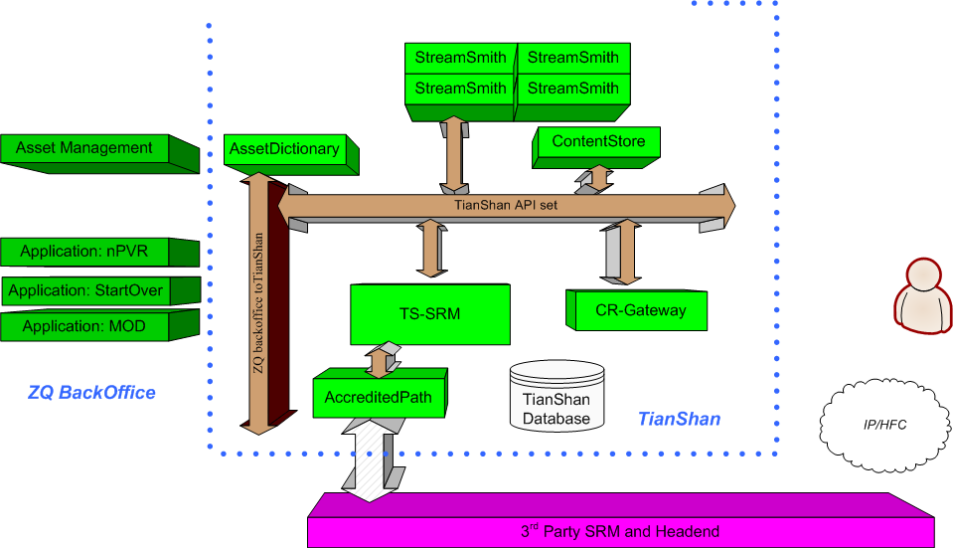

Architectural WorkThru
glancing resource requirement collection
Resource narrowing
Notes:
Order a stream
Create session
Do application logic routing
Application service
SRM
AccreditedPath = Transport

Slide 10
Interfaces and Logical Components
Object-oriented Interfaces: TianShan API
  Session and Resource
  AccreditedPath ticketing and integrated ticketing
  Streamer
  ContentStore
SRM
  Business logic router: determine which application service should be invoked with a specific session setup context
  Session management: a database-powered entity management with lifecycle management
  Load balancing
  Resource Proxy, resource data schema and gateway to SRM
Transport (former AccreditedPath)
  An automation to find potential streaming network path with give parameters: 3 entities and 2 links
  A ticketing system and lifecycle management, portable narrowing algorithm
  Work as a SRM simulation when 3rd-party SRM is not available

Slide 11
Interfaces and Logical Components (cont-1)
StreamService
  The implementation of Streamer
  Server-side playlist executor
  The consumer of AccreditedPath ticket
CR-Gateway
  A gateway to translate client request (RTSP, DSMCC and more) to Tianshan API
    Session setup/teardown/ping
    Stream control: play/pause/FF/REW/Seek
  Client connection management
  Scalable – system capability
ContentStore - a proxy of a content storage
  Implementation of ContentStore Interface
  Various content provision methods and management
  Agent of content propagation
  Commander of media process
Tianshan API to 3rd Party API gateway – a set of components for integration
  i.e. AssetDictionary

Slide 12
Comparison with Other Architectures
Feature | TianShan | TWC-ISA | Comcast-NGOD | SA-DBDS | UT Starcom
Object-Oriented interfaces | Y | Y | N | N | ?
Virtual site hosting | Y | N | N | N | N
Open value-add application Interface | Y | Y | SSP | ? | ?
Open billing interface | Y | Y
Central billing system support | Y | Y | Y | Y | Y
Customer billing system support | Y | N | N | N
Multiple-portable-application support | Y | ? | N | N | ?
Central asset management support | Y | Y | Y | ? | ?
User-defined asset management support | Y | N | N | N
Per-application asset management support | Y | N | N | ? | ?
Cross-application asset and media sharing | Y | N | N | N | ?
Boardcast (non-OnDemand) application support | Y | N | N | ? | ?
HFC network support | Y | Y | Y | Y | N
IPTVsupport | Y | N | N | N | Y
Mixed HFC and IPTV service support | Y | N | N | N | N
External resource management support | Y | N | Y | ? | ?
Ad inserting during ordering | Y | Y | N | N | ?
Ad inserting during streaming | Y | N | N | N | ?
f1 | ? | ? | ? | ? | ?

Slide 13
The TianShan Product and Key Components
The TianShan Product Kit
  Weiwoo and Path Helper Objects
  SiteAdminService
  StreamSmith
  RTSP Proxy and ssm Plugins
  ContentStore
  ContentProvisionEngine and Content Provision Helpers
  Foudational Application Services: MovieOnDemand, ChannelOnDemand
  Sentry
  EventChannel and EventGateway
  Components of DataOnDemand
  Virtual StreamServices

Slide 14
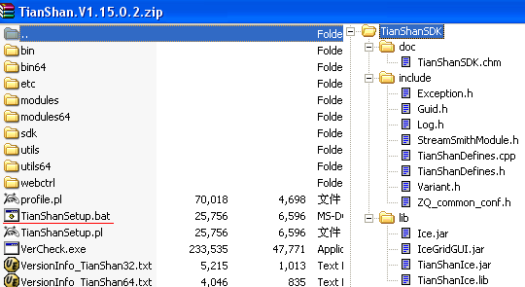
The TianShan Product Kit
The TianShan Installation Kit
  Primary binaries
  Modules
  Configuration files
  WebCtrl presentation
The Software Development Kit
  Documentation
  C/C++
  Java
Scripts and Utilities
  TianShanSetup
  Log Collecting
  Tail
  VerCheck
  TrickGen
  RTIGen

Slide 15
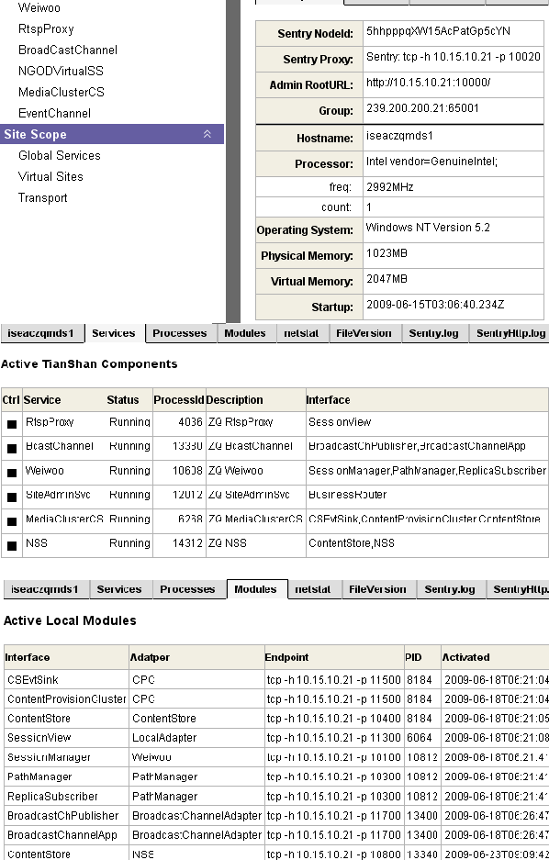
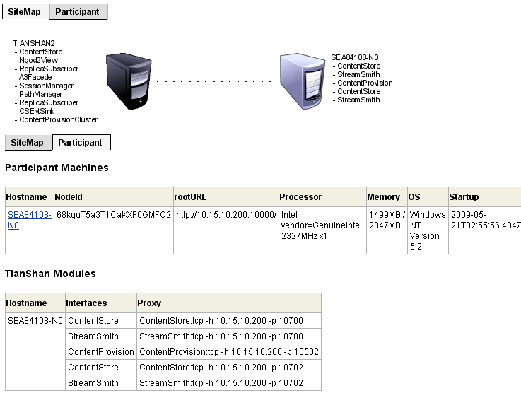
The TianShan Product Kit (cont-1)
Views on Sentry UI
  The overall view of a site
  Per-machine installation
  Per-service view
    Preference
    Objects/Entities/Status
    Published log files

Slide 16
Components (cont-1)
Weiwoo and Path Helper Objects
  Weiwoo consists of SessionManager and Transport Manager
  Session management: session state machine and lifecycle, key joint among TianShan components
  Abstraction layer of transport: storage→ streamer →end-user
  Weiwoo is a plugin framework of PHO plugins
  PHO_SeaChange.dll consists the PHOs for SeaChange MediaCluster products
    SeaChange. Raid5^2
    SeaChange.IpEdge.IP
    SeaChange.IpEdge.DVBC
    SeaChange.IpEdge.DVBC.ShareLink
SiteAdminService
  Consists of BusinessRouter and Transaction Service
  Virtual sites and application mounting
  Dispatches to application services
  Quota validation

Slide 17
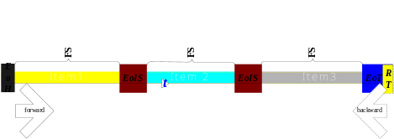
Components (cont-2)
StreamSmith
  An implementation of StreamService over SeaChange MediaCluster products
  Server-side dynamic playlist engine
  Internal ContentStore module: MediaServerCS
RTSP Proxy and ssm Plugins
  RTSP Socket Server, connection and session managment
  Plugin framework to customize the RTSP extention
  Ssm_TianShan_C1 implements the SeaChange RTSP Protocol (TianShan Edition)
  Ssm_RichURL extends URL with rich parameters
  Ssm_NGOD2 implements the NGOD R2/C1 RTSP specification

Slide 18
Components (cont-3)
ContentStores
  MediaClusterCS – former ClusterContentStore, provides the volume and content access to SeaChange MediaCluster via a unified file system. It gathers the communication to multiple MediaServerCS instances and represent them as one. It is also the central management of the distributed content provision engines
  MediaServerCS – former NodeContentStore, becomes an internal module of StreamSmith. It implements the volume and content access over Vstream on the node. It can work as the slave instance when MediaClusterCS is involved
ContentProvisionEngine and Content Provision Helpers
  The CPE service -- is a distributed content provisioning engine, it fetches the media content from the source, performs the necessary SeaChange trick generation and import the prepared media content into the SeaChange MediaCluster volume. It is a plug-in framework to host various content provision methods as needed
  CPH_RTFRDS
  CPH_RTI
  CPH_RTINAS
  CPH_NASCopy
  CPH_nPVR
Notes:
CPH_RTFRDS
CPH_RTFRDS is a Content Provision Helper (CPH) plugin loaded by the CPE service. It supports the active FTP or CIFS pull and passive FTP push. It performs SeaChange RTF or CTF trick generation and performs index pacing for the real time sessions. It can be specified to output to Windows compatible filesystem or Vstream SeaFile
CPH_RTI
CPH_RTI is another Content Provision Helper (CPH) plug-in loaded by the CPE service. It captures multicast IP stream and process the data via SeaChange RTF or CTF trick generation and performs index pacing for the real time sessions. It is known as an effective media recording

Slide 19
Components (cont-4)
Foundational Application Services
  MovieOnDemand – the MovieOnDemand service provides the basic business rules of the movie-on-demand application. It offers the interface allow the VOD entertainment back office to customize on authorization, playlist build up, bookmarking and more. Besides the basic move-on-demand, the MOD service is designed to easy to wrap extended applications such as nPVR and movie survey.
  ChannelOnDemand – the ChannelOnDemand (ChodSvc) provides a publish point interface allow user to define a channel and be available for on-demand ordering. It allow people management the published channel by insert, delete, replace items while the streaming sessions have been started. The ChannelOnDemand application also provides the interfaces to customize authorization, bookmarking and more. It is known easy to wrap to some extended application such as PausedTV and StartOverTV

Slide 20
Components (cont-5)
Sentry – deploy on each TianShan participant machine.
  Monitors the local components and represents their status and runtime information via web UI.
  Its web UI is also an interface to manage and configure the settings of virtual sites and transport paths
  The Sentry instance gathers the local transitional information and forward to enrich the data in EventChannel
EventChannel and EventGateway
  The EventChannel service offers an m-to-n message delivering system via publisher-to-subscriber mode. It is shared by all the TianShan components as a messaging bus. The 3rd-party may also borrow it for transaction monitoring and dataware housing
  The EventGw service is designed to dispatch or forward the attented TianShan events from the event channel to the 3rd Party in the integration scenarios, it offers a plugin framework to customize the messages to the destination. Some implementations of the plugins are also shipped in the TianShan installation kit known as Event Gateway Helpers (EGH)
The Sentry, EventChannel, EventGateway with the EGHs on alarm also make up the monitoring and alarm subsystem in a TianShan deployment

Slide 21
Components (cont-6)
Components of DataOnDemand
  DataStreamService
  DataAppService
Virtual Stream Services
  NSS
  TMVSS
  VLCSS

Slide 22
Deployments and Support
Deployments
  Standalone Node
  Cluster-ed and Multiple Clusters
  Comcast NGOD Architecture
  SeaChange CDN Products

Slide 23
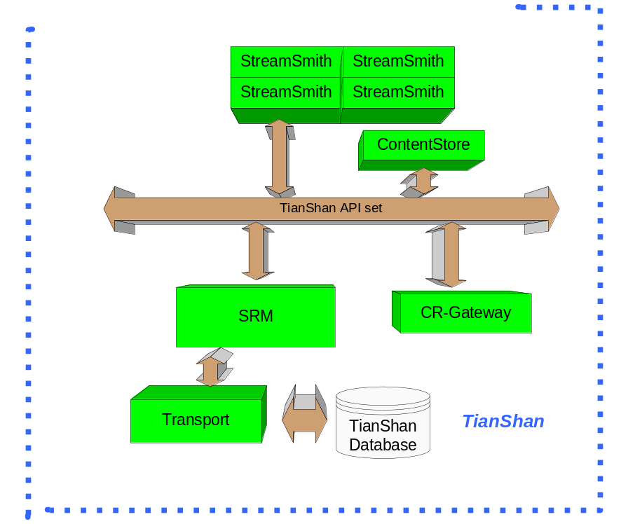
Deployments (1- standalone)
No 3rd-party SRM then we create a local database definition to configure the resource
The application can be as simple as something embedded in side of StreamSmith or CR-Gateway plugin

Slide 24
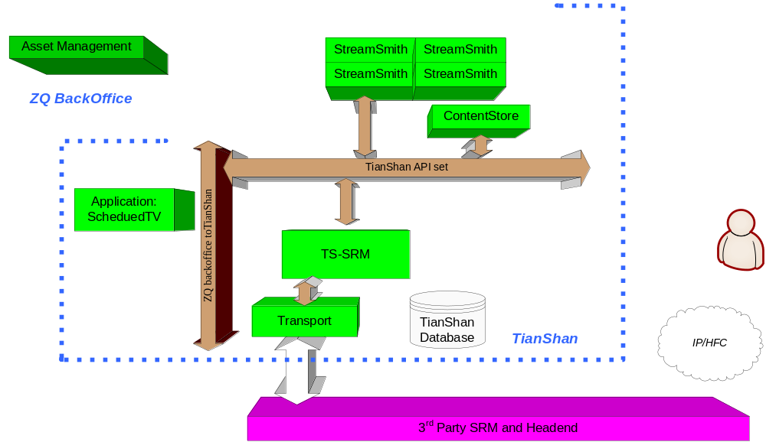
Deployments and Support (2 – server-driven application)
Notes:
ScheduledTV as an example, used must have a client-side to start a session
CR-gateway is unnecessary
Application server order stream directly thru TianShan API

Slide 25
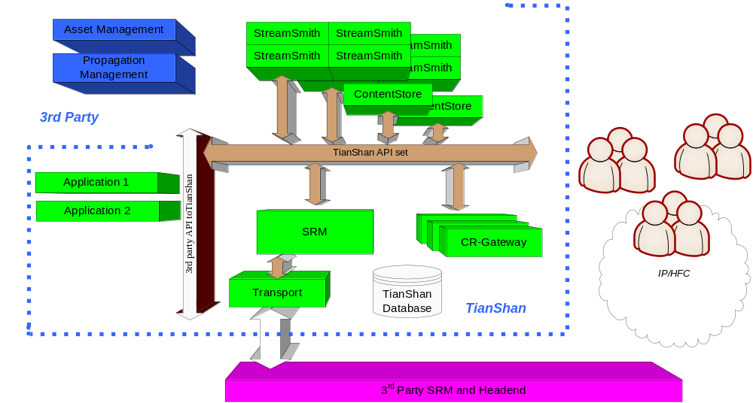
Deployments and Support (cluster-ed and multiple clusters)
Notes:
3rd party API to TianShan API gateway
Multiple CR-Gateway to handle requests from more clients
More contentStore and streamers to provide powerful streaming
Asset management is powered with propagation management

Slide 26
Summary
Business logic oriented
  Support various applications
  End-user friendly
Network oriented
  Integration opportunities
  Real time network condition
Scalability and Balancing

